Slide 1

TARGET FOLDER
SRNTGT023
Ostrovnoy Naval HQ, SRN
SECRET - DCS WORLD
REL TO COALITION
SECRET - DCS WORLD
REL TO COALITION

Slide 2

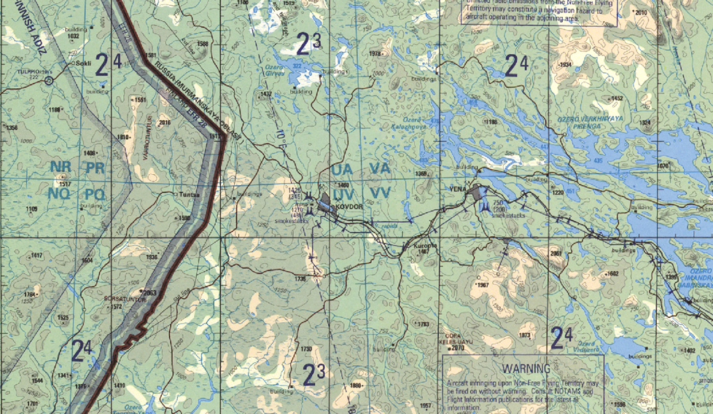
Kovdor Research Facility, SRN
OPAC CLASSIFIED REL TO CJTF-23
JOINT OPERATIONS GRAPHIC [1]
MAP
OVERVIEW
BE: SRNTGT016 CATCODE: 5
MIDB GEO: N67 34.035 E030 27.792
ICOD: 2011-FEB-11 DOI:2011-FEB-02
DECL ON: 2061-FEB-11
N
.
Kovdor Research Facility SRNTGT016

Slide 3
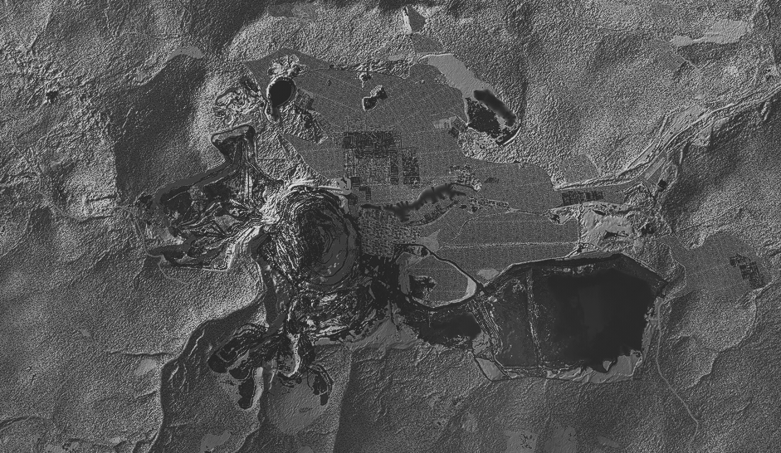
Kovdor Research Facility, SRN
OPAC CLASSIFIED REL TO CJTF-23
FACILITY OUTLINE GRAPHIC 1/1
MAP
OVERVIEW
BE: SRNTGT016 CATCODE: 5
MIDB GEO: N67 34.035 E030 27.792
ICOD: 2011-FEB-11 DOI:2011-FEB-02
DECL ON: 2061-FEB-11
N
Kovdor Research Facility
SRNTGT016
SRNTGT091

Slide 4
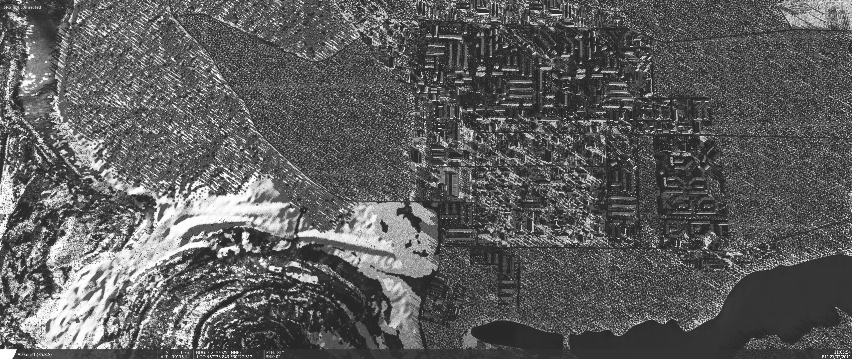
Kovdor Research Facility, SRN
OPAC CLASSIFIED REL TO CJTF-23
DESIRED POINT OF IMPACT GRAPHIC 1/1
MAP
OVERVIEW
BE: SRNTGT016 CATCODE: 5
MIDB GEO: N67 34.035 E030 27.792
ICOD: 2011-FEB-11 DOI:2011-FEB-02
DECL ON: 2061-FEB-11
N
DPI: SRNTGT016-A
LABORITORY 1
N 67 34.042 E 034 28.042
DPI MSL: 800 FT
DPI: SRNTGT016-D
POWER SUPPLY LABORITORY 2
N 67 34.052 E 034 27.750
DPI MSL: 790 FT
DPI: SRNTGT016-C
POWER SUPPLY LABORITORY 1
N 67 34.052 E 034 27.800
DPI MSL: 800 FT
DPI: SRNTGT016-B
LABORITORY 2
N 67 34.049 E 034 27.640
DPI MSL: 780 FT
DPI: SRNTGT016-E
FUEL STORAGE FOR POWER SUPPLIES
N 67 34.029 E 034 27.739
DPI MSL: 790 FT
DPI: SRNTGT016-F
CHEM STORAGE FOR POWER SUPPLIES
N 67 34.000 E 034 27.745
DPI MSL: 780 FT

Slide 5
Kovdor Research Facility, SRN
OPAC CLASSIFIED REL TO CJTF-23
WEAPONEERING OPTIONS 1/1
MAP
OVERVIEW
BE: SRNTGT016 CATCODE: 5
MIDB GEO: N67 34.035 E030 27.792
ICOD: 2011-FEB-11 DOI:2011-FEB-02
DECL ON: 2061-FEB-11
DPI | DESCRIPTION | TLE | WARHEAD | GUIDANCE | DESIRED EFFECT | IMPACT ANGLE | FUZING
A,B | SS CONCRETE LAB BUILDING | CAT 3 | 1000 lbs | METRIC | BLAST | 60-90 | 25ms
C,D | SS FLAT ROOF POWER DISTROBUTION | CAT 3 | 500 lbs | METRIC | BLAST | 60-90 | 10ms
E | FUEL STORAGE SILO DOUBLE SKIN | CAT 3 | 1000lbs | METRIC | BLAST | 60-90 | 25ms
F | REVETTED CHEMICAL STORAGE | CAT 3 | 1000lbs | METRIC | BLAST | 60-90 | 0ms

Slide 6
Kovdor Research Facility, SRN
OPAC CLASSIFIED REL TO CJTF-23
COLLATERAL DAMAGE ESTIMATION GRAPHIC 1/1
MAP
OVERVIEW
BE: SRNTGT016 CATCODE: 5
MIDB GEO: N67 34.035 E030 27.792
ICOD: 2011-FEB-11 DOI:2011-FEB-02
DECL ON: 2061-FEB-11
N
DPI A
DPI E
NCC: RESIDENTIAL AREA SURROUNDING TARGET
CER 250M / 812FT
CDE5, CIVILIAN RESIDENTIAL AREA INSIDE 800ft.

Slide 7
Kovdor Research Facility, SRN
OPAC CLASSIFIED REL TO CJTF-23
COLLATERAL DAMAGES ESTIMATION 1/1
MAP
OVERVIEW
BE: SRNTGT016 CATCODE: 5
MIDB GEO: N67 34.035 E030 27.792
ICOD: 2011-FEB-11 DOI:2011-FEB-02
DECL ON: 2061-FEB-11
COLLATERAL DAMAGES WITHIN A 500M RADIUS
DESCRIPTION |  | CATCODE | MIDB GEOS | LOCATION | REMARKS
CIVILIAN INDUSTRIAL UNITS |  | 13 |  | 300FT | Potential Civilian Casualties
UNKNOWN LIQUID/GAS STORAGE |  |  |  | 100FT | Potential Secondary Explosions
NO STRIKE ENTITIES WITHIN A 500M RADIUS
NSE ID | DESCRIPTION | CATCODE | MIDB GEOS | LOCATION | REMARKS

Slide 8
Kovdor Research Facility, SRN
OPAC CLASSIFIED REL TO CJTF-23
BATTLE DAMAGE ASSESSMENT GRAPHIC 1
MAP
OVERVIEW
BE: SRNTGT016 CATCODE: 5
MIDB GEO: N67 34.035 E030 27.792
ICOD: 2011-FEB-11 DOI:2011-FEB-02
DECL ON: 2061-FEB-11
POST-STRIKE
PRE-STRIKE
N
TARGET OBJECTIVE
DAMAGE/CHANGE ASSESSMENT
DPI:[XXXXXX]
BDA REMARK: [CLASSIFICATION] [DISSEMINATION] Assessment: Physical Damage/change, Collateral Damage, Functional Damage/change, Munitions Effectiveness, Reattack Recommendation, Additional/Collateral Effects

Slide 9

ACRONYMS
ACRONYM | MEANING | DEFINITION
BE | Basic Encyclopedia Number | Alpha/numeric code unique to an installation for incorporation within various national and tactical systems.
CATCODE | Category Code | The data Element that classifies the function and purpose of an installation or a facility.
MIDB | Modernized Integrated Database | A database comprised of information on facilities of military significance, military forces, and related equipment.
ICOD | Intelligence Cut Off Date | The date of the latest intelligence data inputted to a feature.
DOI | Date of Image | Date on which a geospatial or intelligence-related image was captured.
CE | Critical Element | An element of an entity or object that enables it to perform its primary function.
PV CHAR | Physical Vulnerability Characteristic | Standardized alphanumeric code describing the physical and structural properties of a target.
JDPI | Joint Desired Point of Impact | A unique, alphanumeric coded aimpoint identified by a three dimensional mensurated point. It represents a weapon or capability desired point of impact or penetration.
CE90 | Circular Error at 90% | 90 percent confidence level in the horizontal plane.
LE90 | Linear Error at 90% | 90 percent confidence level in the vertical dimension
MSL | Mean Sea Level | Elevation above Earth reference geoid.
AGL | Above Ground Level | Elevation above ground surface.
NCC | Nearest Collateral Concern | Closest non-targeted structure, area, or entity near a planned point of impact that may be at risk of unintended damage during a military strike.
CER | Collateral effects radius | Radius within which collateral damage might happen based on the weapon's characteristics, the target environment, and other operational factors.
CDE | Collateral damage estimate | Systematic process used in military targeting to evaluate the potential for unintended damage or harm to non-combatant entities, structures, or personnel as a result of a planned strike.
NSE | No Strike Element | Specific entities, locations, or objects that are protected from intentional targeting under the Law of Armed Conflict (LOAC) or by operational policy.

